Slide 1




BANK LOAN CASE STUDY
Surani Smit

Slide 2

AGENDA
Project Description
Approach
Tech-Stack Used
Data-set
Insights
Result
120+

Slide 3

Project Description
The given dataset is related to Bank Load .
company faces challenges with some customers defaulting on their loans.
The main aim of this project is to identify patterns that indicate if a customer will have difficulty paying their installments.
This information can be used to make decisions such as denying the loan, reducing the amount of loan, or lending at a higher interest rate to risky applicants.
The company wants to understand the key factors behind loan default so it can make better decisions about loan approval
120+

Slide 4
Approach
For this project, first we'll get understanding of the given data.
Then We'll clean the data as per our requirement by removing null values, delete unnecessary columns, etc.
Then We'll Find outliers,Outliers can significantly impact the analysis and distort the results.
After that we'll using pivot table, various functions, and charts for desired answers for the questions.
At the end we'll present our answers with proper formatting in table and garaphs.
120+

Slide 5
Tech-Stack Used
Microsoft Excel: This tool is used to create graphical representation of the results and to understand the result set better.
Canva : compile on observation based report
120+
Data-set :
https://drive.google.com/file/d/1XpGThHzLnXxL_7aQo2sCpYL3SeB18MMB/view

Slide 6
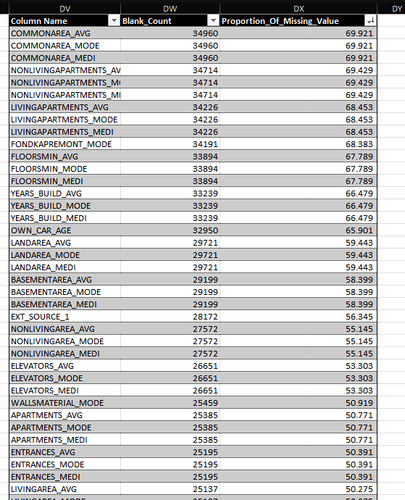
Insights
A. Identify Missing Data and Deal with it Appropriately : Identify the missing data in the dataset and decide on an appropriate method to deal with it using Excel built-in functions and features.

Slide 7
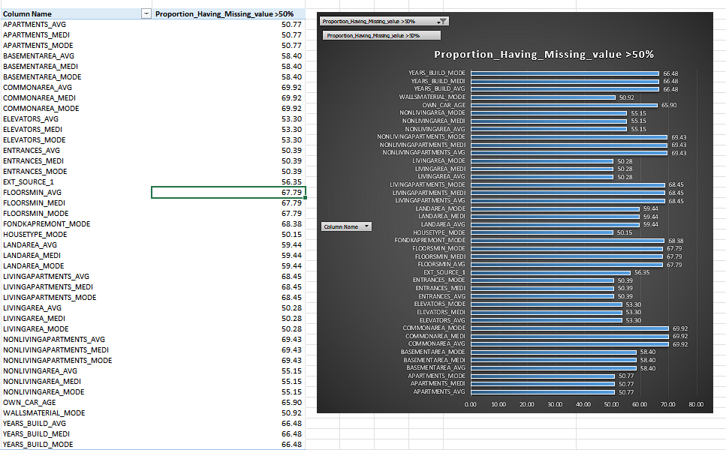
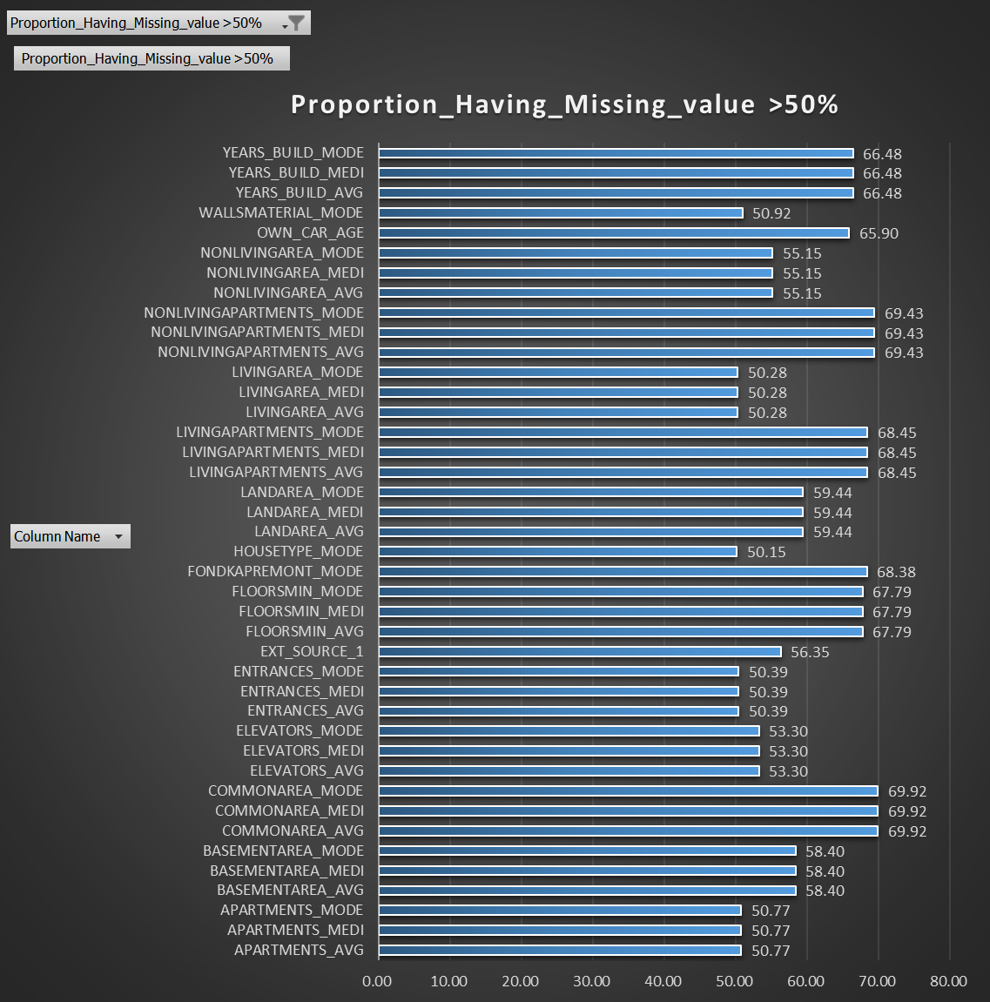

Slide 8
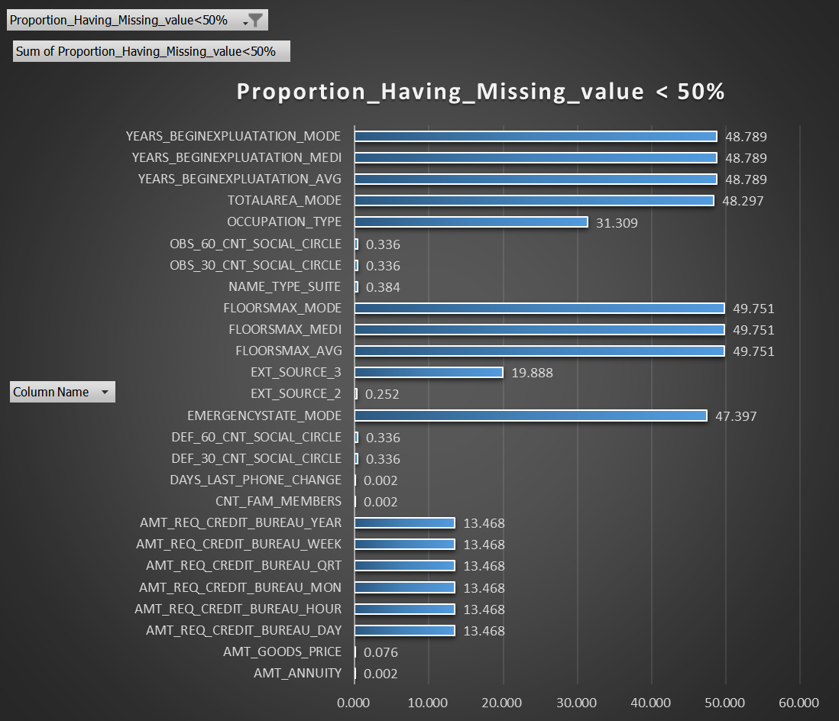
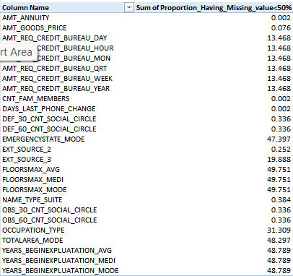

Slide 9
We may observe that this data set has a large number of rows and columns.
There are about 132 columns with missing values.
After determining that about 40 of the columns had more than 50% of the values missing, I decrypted the data to delete every column with more than 50% of the values missing.
Following the value's removal, there should be about 90 columns.

Slide 10
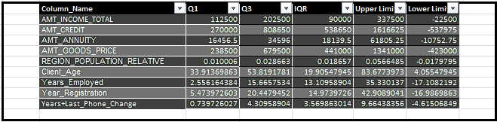
B. Identify Outliers in the Dataset: Detect and identify outliers in the dataset using Excel statistical functions and features, focusing on numerical variables.
I Utilize Excel functions like QUARTILE, IQR, and conditional formatting to identify potential outliers.

Slide 11
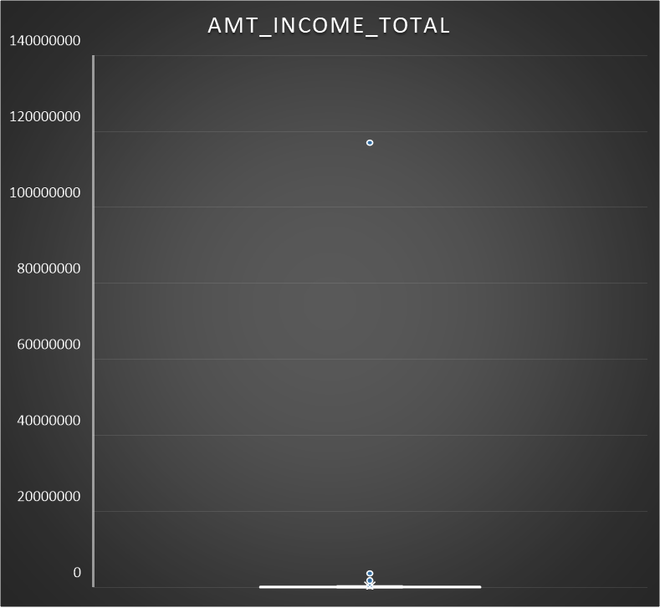
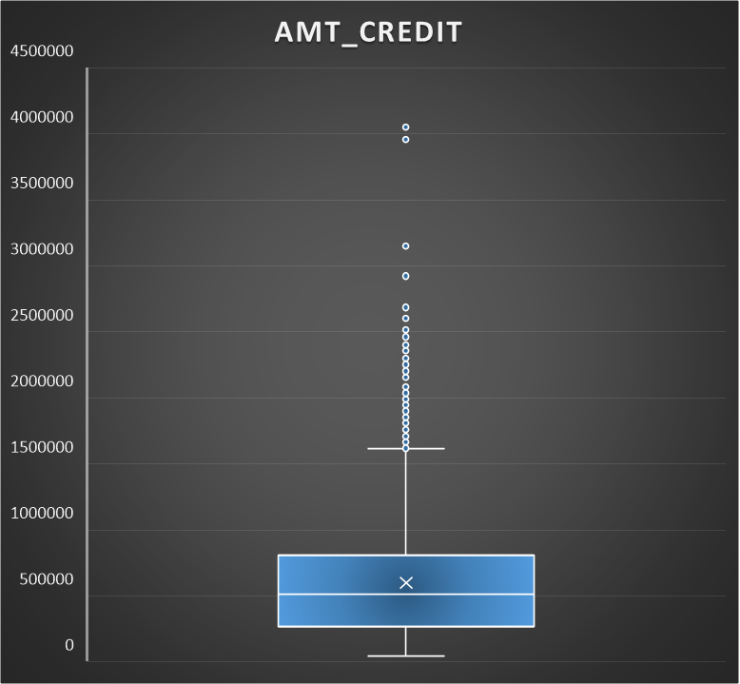

Slide 12
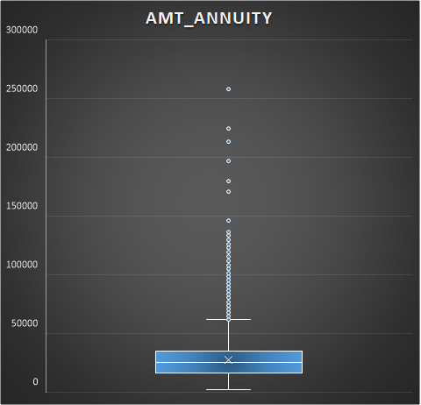
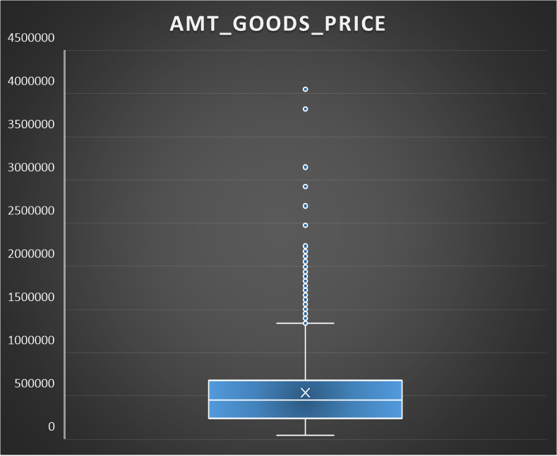

Slide 13
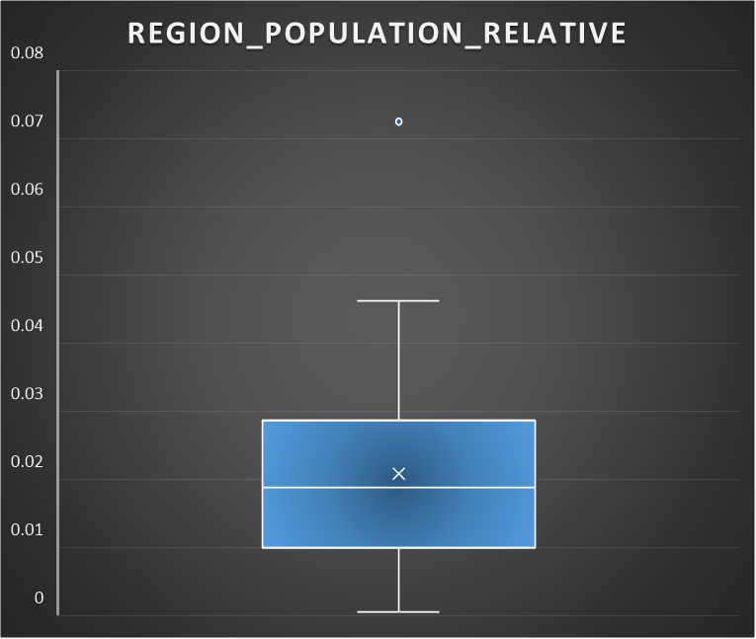
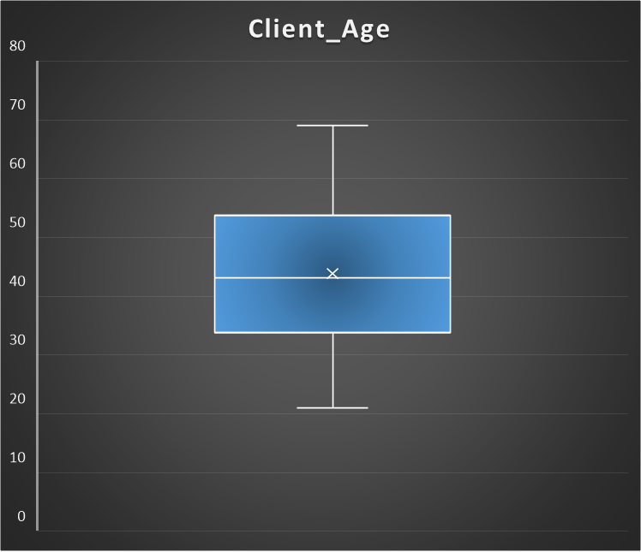

Slide 14
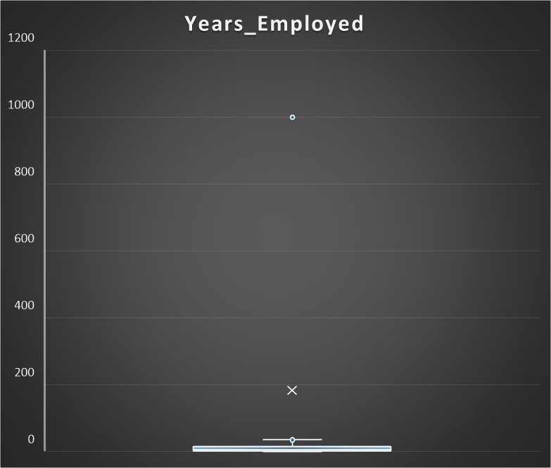
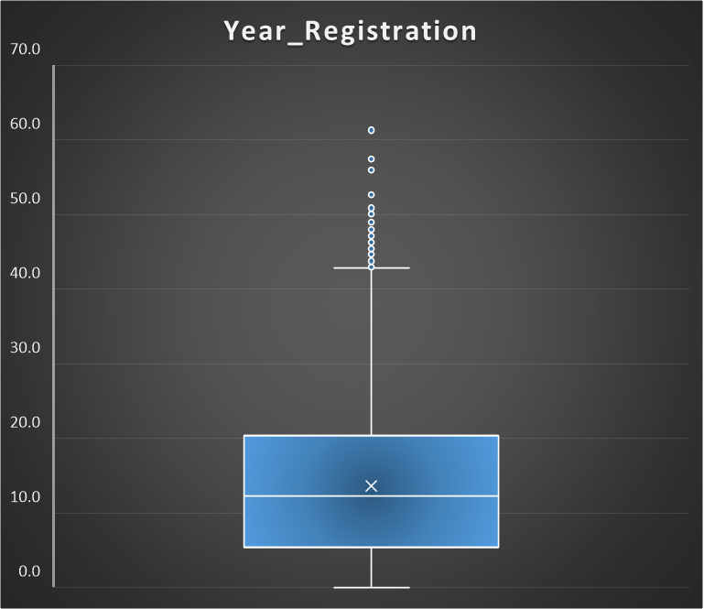

Slide 15
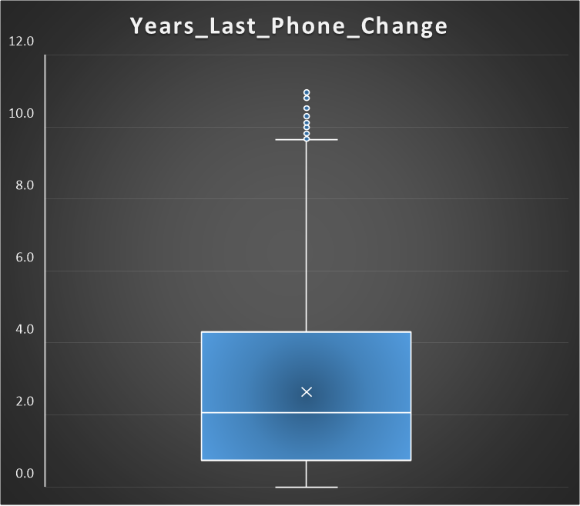
I'm using a box plot to investigate the outlier in our data set here.
There are about 50,000 rows in the bank loan data set, however after eliminating outliers, there are about 36048 rows remaining. I removed this data because I found outliers in multiple columns.
Thus, we are prepared to proceed with the analysis after eliminating all superfluous columns that contain missing values greater than 50% and data with outliers.

Slide 16
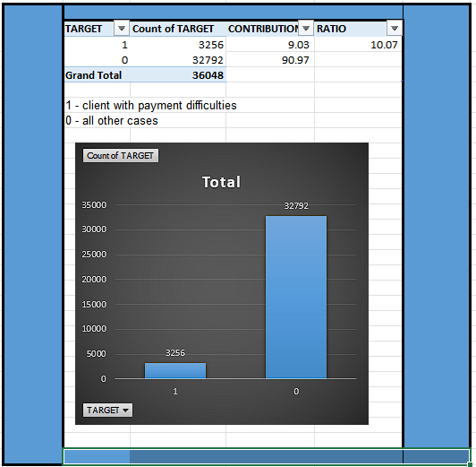
C. Analyze Data Imbalance: Determine if there is data imbalance in the loan application dataset and calculate the ratio of data imbalance using Excel functions.
The dataset is highly imbalanced, with asignificant majority of instances belonging toclass O (Non-Defaulter-91%) and a minoritybelonging to class 1 (Defaulter-9%)
Challenges: Predicting class 1 accurately may be difficult due to its minority representation.

Slide 17
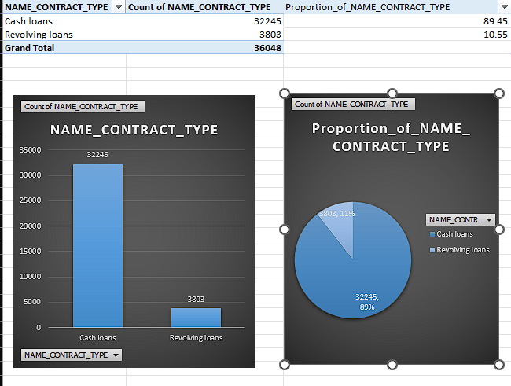
here we can see contract type is also highly imbalanced, with asignificant majority of instances belonging to class Cash Loans has around 89.5% Proportion and a minority belonging to Revolving Loans -10.5%

Slide 18
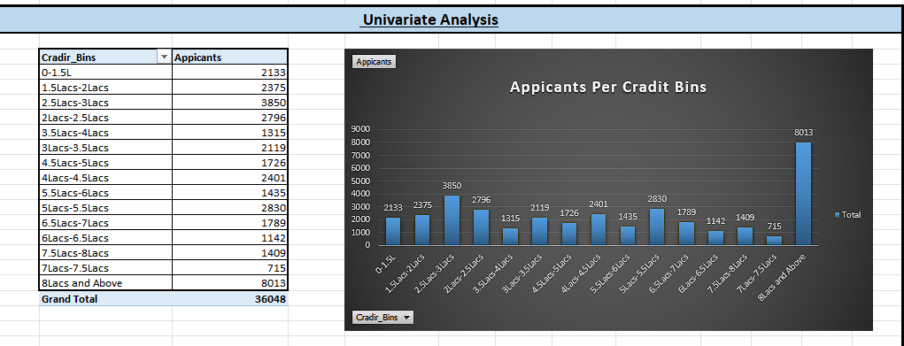
D. Perform Univariate, Segmented Univariate, and Bivariate Analysis: Perform univariate analysis to understand the distribution of individual variables, segmented univariate analysis to compare variable distributions for different scenarios, and bivariate analysis to explore relationships between variables and the target variable using Excel functions and features.

Slide 19
The chart shows that most of the applicants fall into certain credit bin groups. This could be used to target marketing or risk assessment efforts.
Here, we can see that the most people have applied for the cradit above 8lacs.
We may thus make judgments based on this information, and we can work with the marketing manager to concentrate on the challenging aspects of the campaign.
.

Slide 20
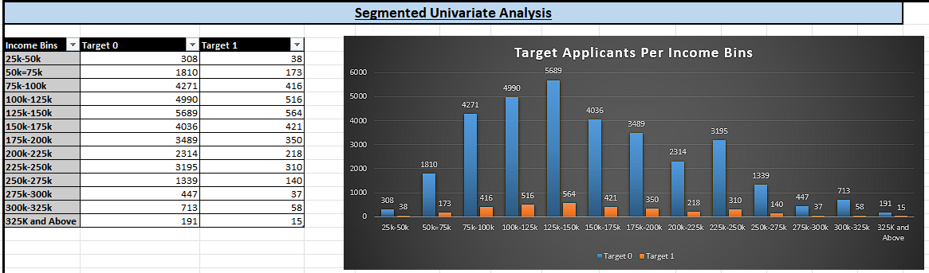
The data has been segmented into income bins, allowing for a closer examination of how the target variables (Target 0 and Target 1) behave across different income levels.
This segmentation helps identify trends or patterns within specific income groups.
Across all income bins, the number of applicants in Target 0 (the majority class) consistently exceeds those in Target 1 (the minority class).
This imbalance could lead to biased models and may need to be addressed.

Slide 21
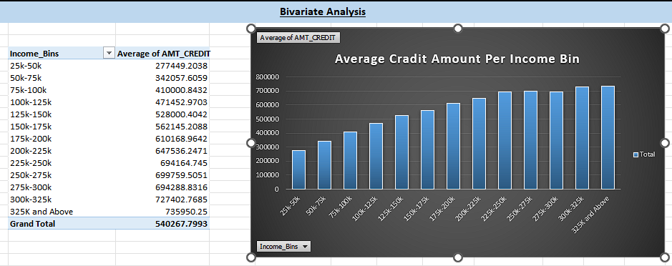
The chart clearly shows a strong positive correlation between income bins and the average credit amount. As income levels rise, the average credit amount tends to increase as well.

Slide 22
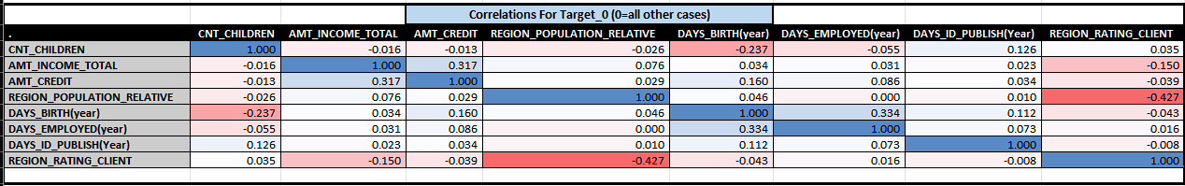
E. Identify Top Correlations for Different Scenarios: Segment the dataset based on different scenarios (e.g., clients with payment difficulties and all other cases) and identify the top correlations for each segmented data using Excel functions.
correlation matrix visualizes the relationship between different numerical variables in a dataset.
From the correlation analysis, we can see that AMT_INCOME_TOTAL and AMT_CREDIT have the moderate positive correlation here, meaning individuals with higher incomes generally have higher credit amounts.
DAYS_BIRTH and DAYS_EMPLOYED also have a moderate positive correlation, suggesting that older individuals tend to have longer employment periods.
And REGION_POPULATION_RELATIVE and REGION_RATING_CLIENT have a moderate negative correlation, which indicates that regions with larger populations often have lower client ratings.
Most of the other correlations are weak, which shows that there's a limited linear relationship between the variables.
The diagonal consists of values of 1.000, representing each variable’s perfect correlation with itself.

Slide 23
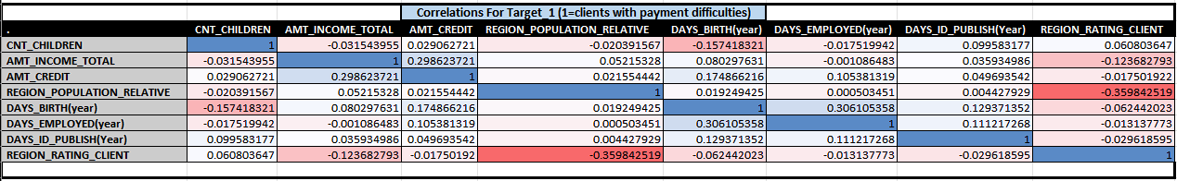
iIn this correlation, one of the important points that should be noted is There's a slightly negative correlation between CNT_CHILDREN and AMT_CREDIT, which suggests that clients with more children might tend to have lower credit amounts.
As observed in the previously target 0 matrix, a weak positive correlation exists between DAYS_BIRTH and DAYS_EMPLOYED, indicating that older clients tend to have longer employment periods.

Slide 24
Result:
In this case study, I applied the EDA to analyze patterns in the data.
Before starting the project, I conduct a brief research on risk analytics inbanking and financial services.
I comprehend how data is employed to reduce the risk of financial losses when extending loans to customers.
This case study has assisted me in acquiring the skill of summarizing extensive datasets to extract valuable insights.
I gained knowledge about data imbalance, outliers, and the underlying factors influencing the datasets.
Click To Open Excel Sheet
Google Sheet Link (If 1st Link not working)

